Slide 1
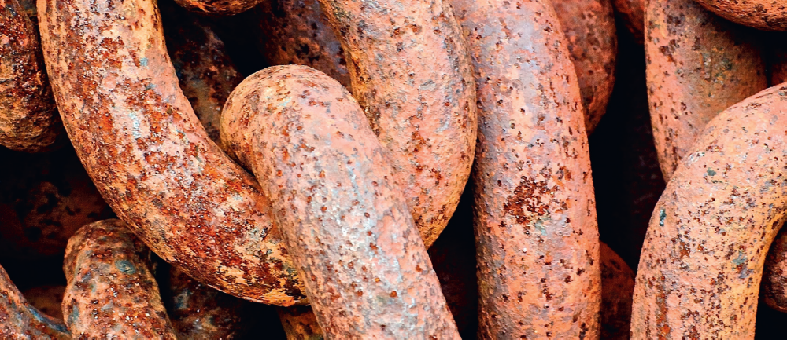
Chapter 4: Chemical reactions

Slide 2
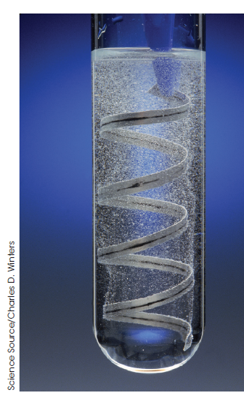
Chemical reactions
All chemical reactions involve the creation of new substances and associated energy transformations.
Energy transformations: evident in changes in the temperature of the surroundings and/or the emission of light.

Slide 3
Chemical equations
Represented by a chemical equation
Reactants are written on the left-hand side of the arrow
Products are written on the right-hand side of the arrow
The arrow always points from reactants to products
The + indicates more than one reactant/product
States: (s) solid, (l) liquid, (g) gas (aq) aqueous solution

Slide 4
Balancing chemical equations
Chemist use balance chemical equations to summarise information
What reactants?
&
What products?
&
The numbers of atoms of each element present
Mg + HCl → MgCl₂ + H₂
one ‘atom’ of Magnesium
two ‘atoms’ of hydrogen
two ‘atoms’ of chlorine
at the beginning & at the end = balanced equation

Slide 5
Reactivity
Chemicals react to achieve stability;
products are more stable than the reactants
During chemical reactions;
old bonds break and new bonds form

Slide 6
Energy is needed to break bonds.
To chemically break down the forces of attraction that occur between:
metal ions and the delocalised electrons in metallic lattices
cations and anions in ionic lattices
non-metallic elements in covalent molecules and covalent lattices
Energy is released when bonds are formed.

Slide 7
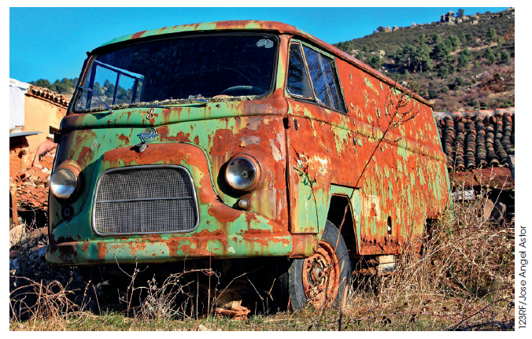
Spontaneous chemical reactions
reactions that occur at room temperature without the input of energy such as heat or electricity.
occur at room temperature
some are quick, some occur slowly

Slide 8
Representing chemical reactions
Net ionic equations
only show the species that change
as they take part in the reaction.
Spectator ions are not included
They are the species which are same on both sides of the ionic equation.
Aqueous species are broken up into their ions.

Slide 9
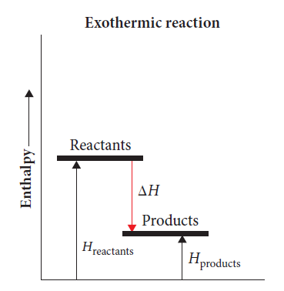
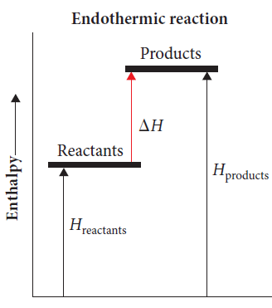
Energy and chemical reactions
Exothermic reactions
Endothermic reactions
Energy is released
Energy of the reactants
> energy of the products
Energy is absorbed
Energy of the reactants
< energy of the products

Slide 10
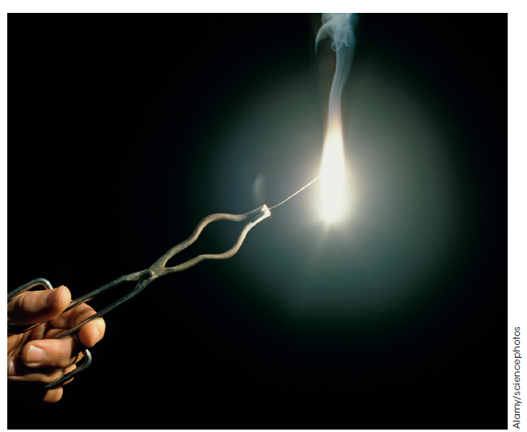
Enthalpy
is the heat absorbed in a chemical reaction at constant pressure.
The change in enthalpy: the heat of reaction,
is given the symbol ∆H. It is measured in kJ mol⁻¹
Exothermic reactions have negative ∆H values. Endothermic reactions have positive ∆H values.

Slide 11
Temperature
An indicator of the change in energy of a substance
Water is heated
heat energy absorbed and temperature increases
Water is cooled
heat energy released and temperature decreases

Slide 12
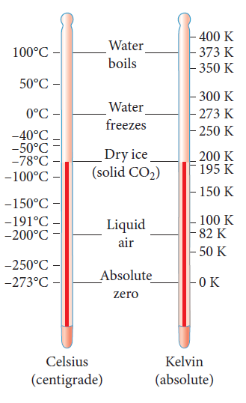
Absolute temperature scale
kelvin (K)
only has positive values
Temperature (ºC) = Temperature (K) -273

Slide 13

Specific heat capacity
The heat needed to increase the temperature of 1 g of the substance by 1 K.

Slide 14
Specific heat capacity
The specific heat capacity of water is 4.18 J K⁻¹ g⁻¹.
4.18 joules of energy is needed to increase the temperature of 1 gram of water by 1 K.
The total amount of energy needed to heat a substance is dependent on the:
mass of the substance
substance; i.e. its specific heat capacity
increase in temperature required.

Slide 15
This can be written as a mathematical equation:
q = mC∆T
where:
q is the quantity of heat involved, in joules (J)
m is the mass of the substance, in grams (g)
C is the specific heat capacity of the substance, measured in J K⁻¹ g⁻¹
∆T is the change in temperature, in kelvin (K).
(final temperature - initial temperature)

Slide 16
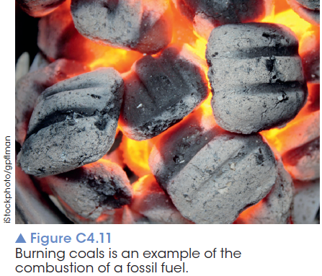
Combustion reactions
Reactions where substances are burnt in the presence of oxygen and release large amounts of energy.
Generally, combustion refers to the burning of fuels to release the energy needed for our daily activities.

Slide 17
Combustion reactions
Fossil fuels are produced over millions of years from decayed animal and plant matter.
Coal, crude oil and natural gas are all fossil fuels. They are the predominant sources of energy used in Australia.

Slide 18
Biofuels
Fuels that are produced from biodegradeable materials such as crops.
Biofuels are classified as renewable sources of fuels since they can be continually produced from crops or algae.
E.g. Biogasoline or green gasoline which has a similar chemical composition to unleaded petrol.

Slide 19
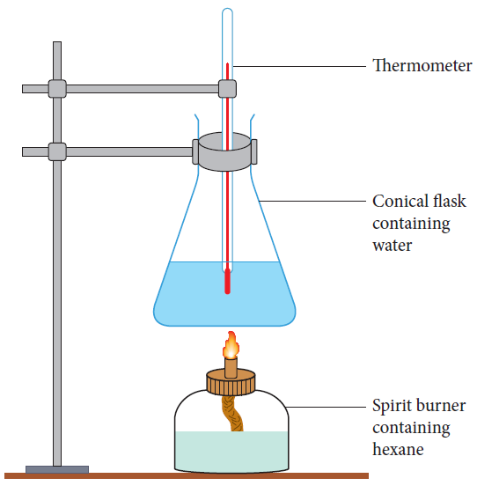
Heat of combustion
The heat released when a fuel undergoes complete combustion at standard atmospheric pressure
Heat absorbed by water = Heat released by combustion of fuel

